Slide 1
Chapter 6
Photovoltaic - 2

Slide 2
PV Systems – Four configurations
1. Grid-connected systems
1.1. Behind-the-meter grid connected PV Systems (customer side; e.g., rooftop; small)
1.2. Utility connected PV Systems or Microgrids (utility side)
2. Off-grid PV systems
2.1. Battery Storage PV Systems
2.2. Direct load PV Systems (water pumping; fence, etc)

Slide 3
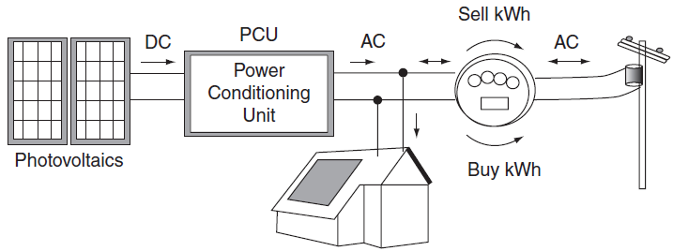
Grid-connected PV system
Behind-the-meter Grid-connected PV systems on the customer’s side:
  No land acquisition costs
  Compete against the much higher retail price of electricity.
Simplified grid-connected PV system with net metering.

Slide 4
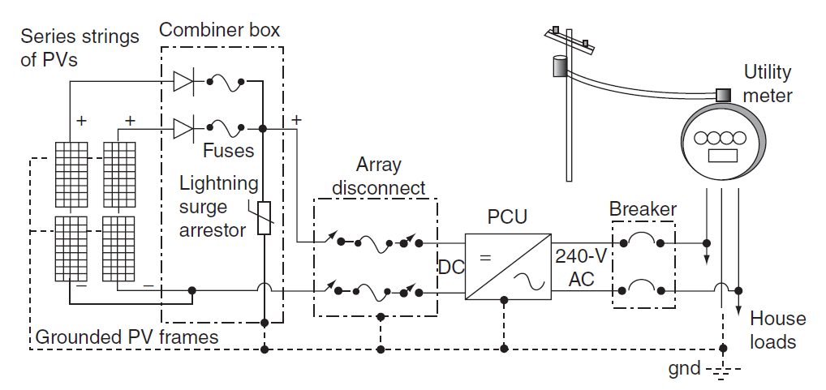
Grid-connected PV system
Power-Conditioning Unit (PCU) includes:
  a maximum power point tracker (MPPT)
  an inverter to convert DC to AC

Slide 5
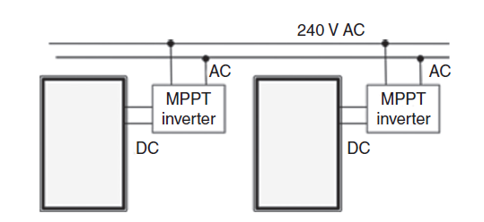
Microinverters
An alternative approach to the single inverter system is based on each PV module having its own microinverter/MPPT.
The advantage:
  Easily allow expansion
  Connections to house distribution panel are simple
  Less need for expensive DC cabling
Disadvantages:
  More expensive than one large inverter

Slide 6
Microinverters
Two ways to reduce the cost of inverter for larger arrays:
  Strings of PV modules may be tied into inverters.
  Large, central inverter systems providing three-phase power to the grid.

Slide 7
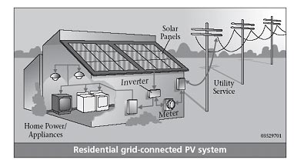
Net metering
Net metering – customer only pays for the amount of energy that the PV system is unable to supply
In the event of an outage, the PV system must quickly and automatically disconnect from the grid
A battery backup system can help provide power to the system’s owners during an outage
Good grid-connect inverters have efficiencies above 90%
http://www.pasolar.ncat.org/lesson05.php

Slide 8
Time-Of-Use (TOU) rates.
The AC output of a grid-connected PV system is fed into the main electrical distribution panel of the house, from which it can provide power to the house or put power back onto the grid.
During the day, excess power from the PV array is sold to the utility; at night, the deficit is purchased from the utility

Slide 9
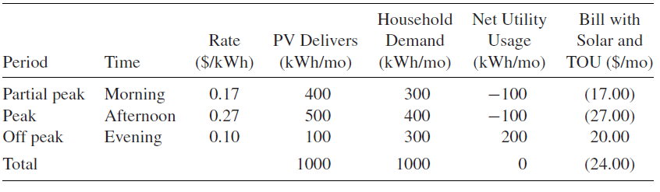
Example of a PV System in the Summer
Example of a PV System that Provides 100% of Electricity Demand for an Example Month in the Summer
The utility owes $24 to the customer but usually, the PV system does not always provide 100% electricity demand
The utility also makes sure through its billing rates that this does not happen

Slide 10
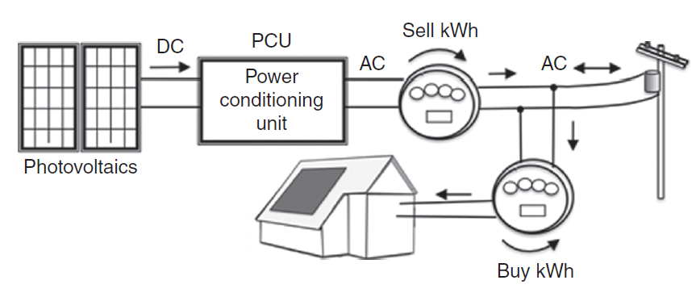
Interfacing with the Utility – feed-in tariffs
Two-meter system
A two-meter system allows a feed-in tariff to provide separate rates for power
generated by PVs and power used by customers.

Slide 11
Predicting performance
PV modules are rated under standard test conditions (STCs):
  a solar irradiance of 1 kW/m^2 (called “1-sun”)
  a cell temperature of 25 deg C
  an air mass ratio of 1.5 (AM1.5).
Under these laboratory conditions, module outputs are thus often referred to as “watts STC” or just “peak watts” (Wp).
In practice, modules are subject to very different conditions and their outputs will vary significantly from the STC rated power.

Slide 12
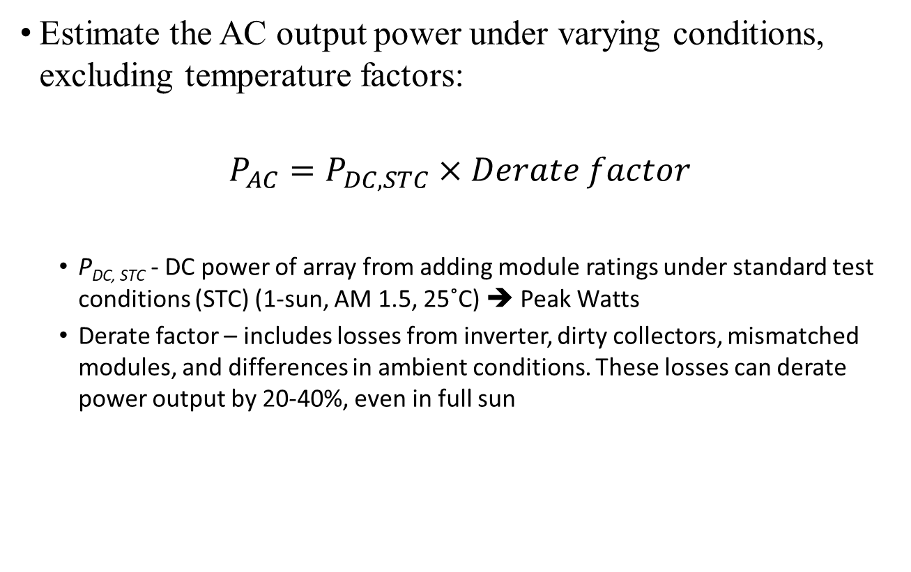
Non-temperature-Related PV Power Derating
Estimate the AC output power under varying conditions, excluding temperature factors:
$$P_{AC}=P_{DC,STC}×Derate factor$$
  P_{DC, STC} - DC power of array from adding module ratings under standard test conditions (STC) (1-sun, AM 1.5, 25˚C) ➔ Peak Watts
  Derate factor – includes losses from inverter, dirty collectors, mismatched modules, and differences in ambient conditions. These losses can derate power output by 20-40%, even in full sun

Slide 13
Losses from Mismatched Modules
Illustrates the impact of slight variations in module I-V curves
Only 330 W is possible instead of 360 W
the loss due to mismatched modules. Each module is rated at 180 W, but the parallel combination yields only 330 W at the maximum power point.

Slide 14
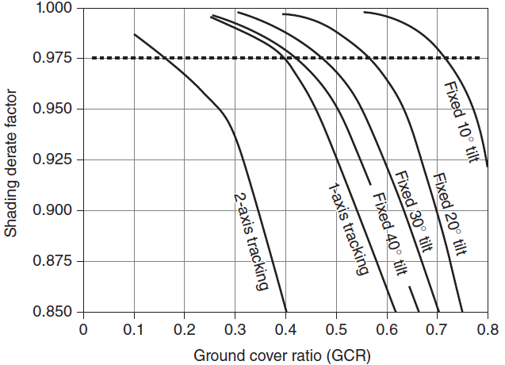
Shading derate factors for various collector configurations
The Ground Cover Ratio (GCR) is the ratio of the area of the PVs themselves to the total ground area.
Smaller GCR means collectors are spaced further apart so shading is reduced and the derate factor is improved.
The dashed line suggests an optimum derate of 0.975.

Slide 15
Losses due to Cell Temperature
As cell temperature increases, power decreases
PVUSA test conditions (PTC) – 1-sun insolation in plane of array, 20˚C ambient temperature, wind-speed of 1 m/s
P_{AC(PTC)} - AC output of an array under PTC test conditions is a better indicator of actual power delivered in full sun than the more commonly used P_{DC(STC)}
Describing a system based on P_{DC(STC)} without correcting for temperature and the inverter is misleading

Slide 16
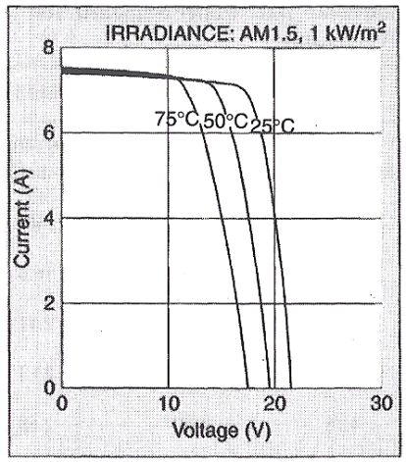
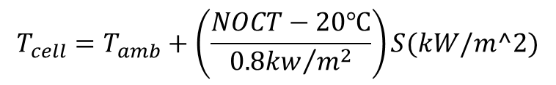
Impact of Temperature
V_{OC} decreases by ~0.37% per ˚C for crystalline silicon cells.
I_{SC} increases by about 0.05% per ˚C.
NOCT – Normal Operating Cell Temperature.
S – Irradiation value.
$$T_{cell}=T_{amb}+\left(\frac{NOCT−20℃}{{0.8kw}/{m^{2}}}\right)S(kW/m^2)$$

Slide 17
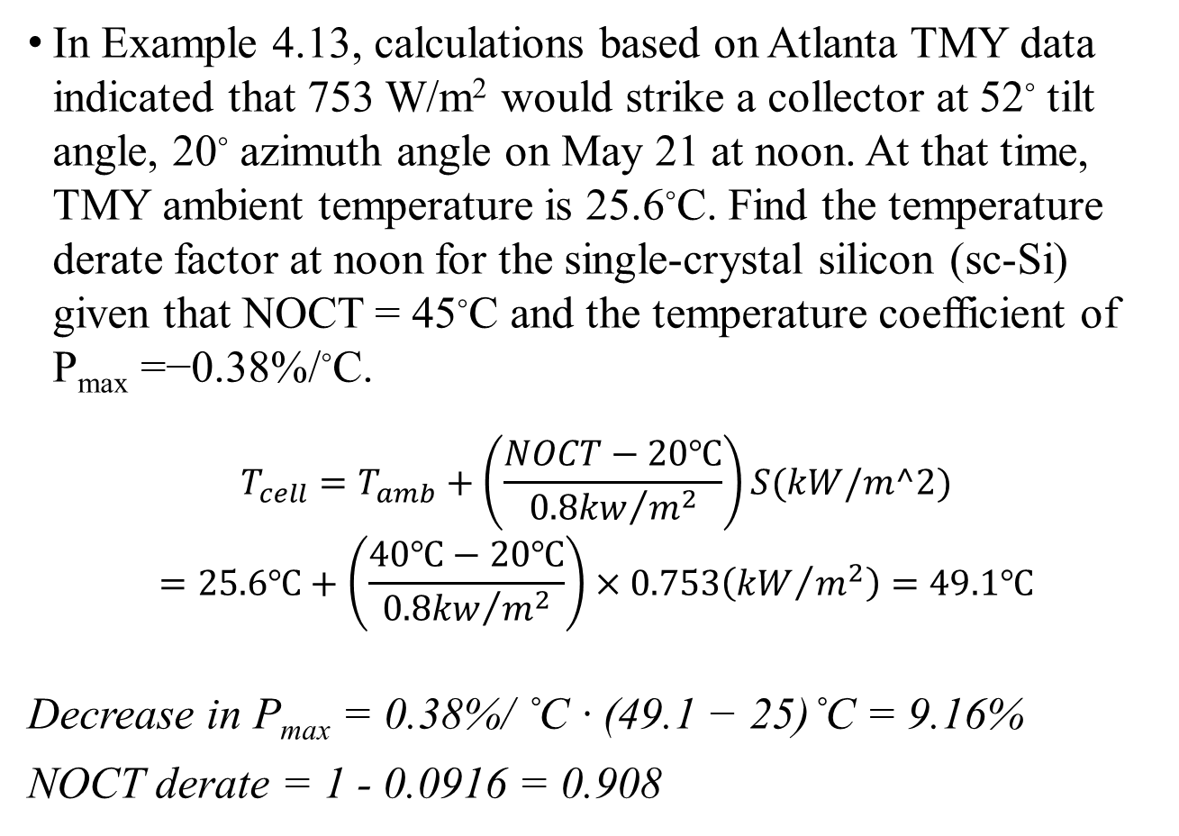
Example of NOCT derate factor
In Example 4.13, calculations based on Atlanta TMY data indicated that 753 W/m² would strike a collector at 52◦ tilt angle, 20◦ azimuth angle on May 21 at noon. At that time, TMY ambient temperature is 25.6◦C. Find the temperature derate factor at noon for the single-crystal silicon (sc-Si) given that NOCT = 45◦C and the temperature coefficient of P_{max} =−0.38%/◦C.
$$T_{cell}=T_{amb}+\left(\frac{NOCT−20℃}{{0.8kw}/{m^{2}}}\right)S(kW/m^2)$$
$$=25.6℃+\left(\frac{40℃−20℃}{{0.8kw}/{m^{2}}}\right)×0.753\left({kW}/{m^{2}}\right)=49.1℃$$
Decrease in P_{max} = 0.38%/ ˚C · (49.1 − 25)˚C = 9.16%
NOCT derate = 1 - 0.0916 = 0.908

Slide 18
Example of PV Derating using PTC
A PV array has rating of 1 kWp under standard test conditions (STC). Nominal operating cell temperature (NOCT) is 47˚C, DC power output drops by 0.5% for every ˚C above the STC temperature of 25˚C. The Mismatched module loss = 3%, the Dirt loss = 4% and the Inverter efficiency = 90%. Estimate P_{AC(PTC)}, the AC output power under PVUSA test conditions (PTC) of 1kW/m².
conditions (PTC) – 1-sun insolation in plane of array, 20˚C ambient temperature, wind-speed of 1 m/s
The estimated cell temperature is
Decrease in P_{DC,PTC} = 0.5%/ ˚C · (53.8 − 25)˚C = 14.4%
NOCT derate = 1 – 0.144 = 0.856
P_{DC,PTC} = 1kW× 0.856 = 0.856kW
Total derate factor = 0.97×0.96×0.90 = 0.83808
P_{AC,PTC} = 0.856kW× 0.83808 = 0.7174kW
OR: P_{AC,PTC} = 1kW× (0.856X0.97X0.96X0.90)= 0.7174kW

Slide 19
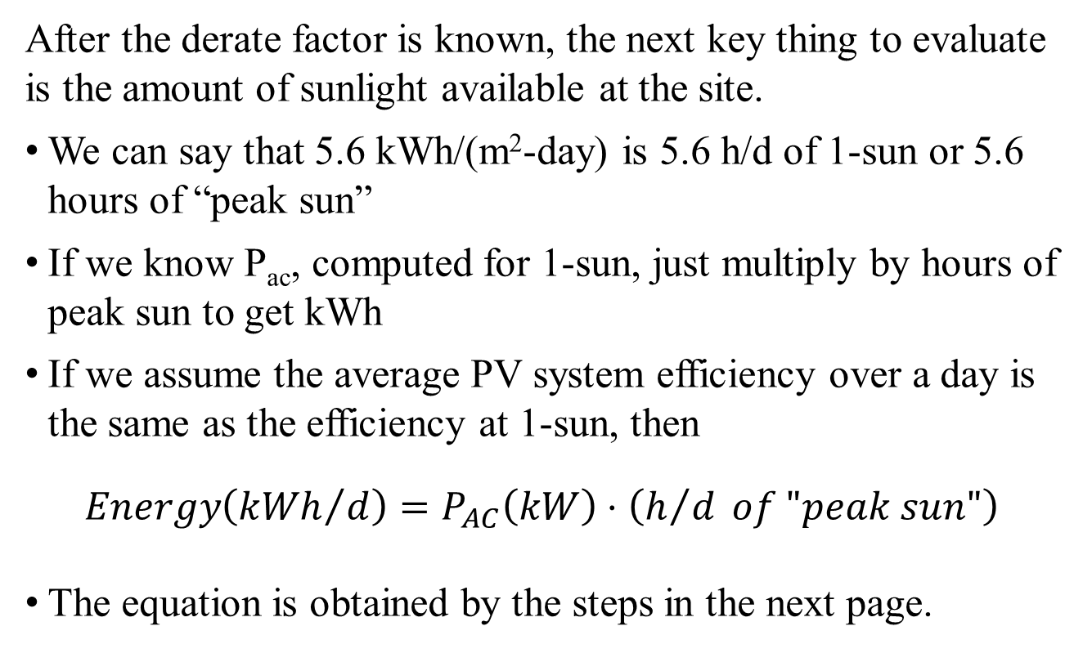
“Peak-Hours” Approach
After the derate factor is known, the next key thing to evaluate is the amount of sunlight available at the site.
We can say that 5.6 kWh/(m²-day) is 5.6 h/d of 1-sun or 5.6 hours of “peak sun”
If we know P_{ac}, computed for 1-sun, just multiply by hours of peak sun to get kWh
If we assume the average PV system efficiency over a day is the same as the efficiency at 1-sun, then
$$Energy\left({kWh}/d\right)=P_{AC}\left(kW\right)⋅\left(h/d of "peak sun"\right)$$
The equation is obtained by the steps in the next page.

Slide 20
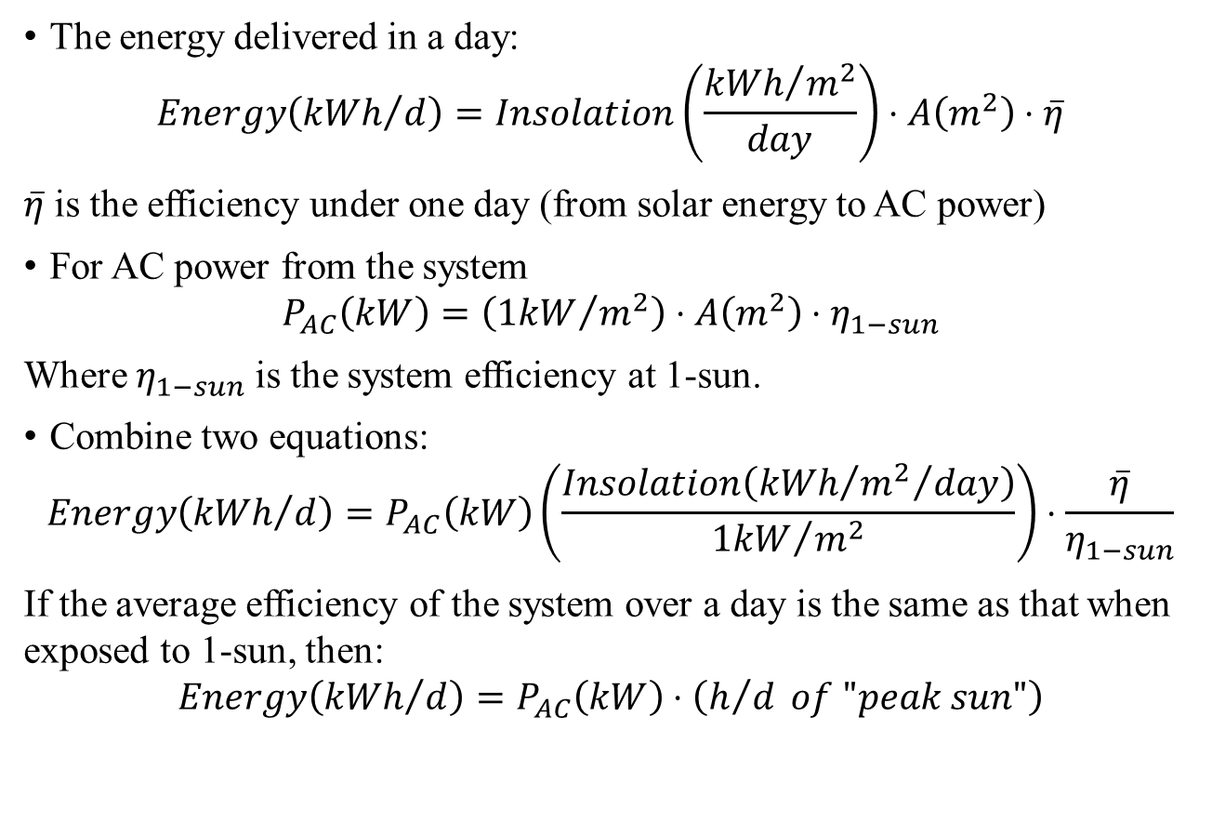
“Peak-Hours” Approach for PV Performance
The energy delivered in a day:
$$Energy\left({kWh}/d\right)=Insolation\left(\frac{{kWh}/{m^{2}}}{day}\right)⋅A\left(m^{2}\right)⋅\overline{η}$$
$\overline{η}$ is the efficiency under one day (from solar energy to AC power)
For AC power from the system
$$P_{AC}\left(kW\right)=\left({1kW}/{m^{2}}\right)⋅A\left(m^{2}\right)⋅η_{1−sun}$$
Where $η_{1−sun}$ is the system efficiency at 1-sun.
Combine two equations:
$$Energy\left({kWh}/d\right)=P_{AC}\left(kW\right)\left(\frac{Insolation\left({{kWh}/{m^{2}}}/{day}\right)}{{1kW}/{m^{2}}}\right)⋅\frac{\overline{η}}{η_{1−sun}}$$
If the average efficiency of the system over a day is the same as that when exposed to 1-sun, then:
$$Energy\left({kWh}/d\right)=P_{AC}\left(kW\right)⋅\left(h/d of "peak sun"\right)$$

Slide 21
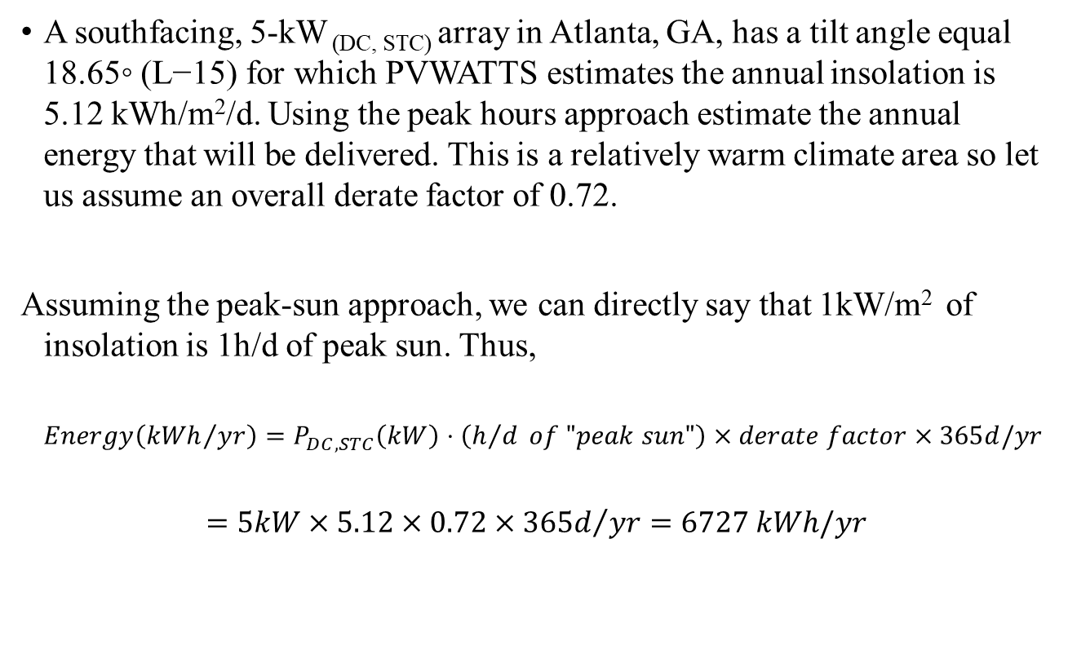
Example of Annual Energy Using the Peak-Sun Approach
A southfacing, 5-kW _{(DC, STC)} array in Atlanta, GA, has a tilt angle equal 18.65◦ (L−15) for which PVWATTS estimates the annual insolation is 5.12 kWh/m²/d. Using the peak hours approach estimate the annual energy that will be delivered. This is a relatively warm climate area so let us assume an overall derate factor of 0.72.
Assuming the peak-sun approach, we can directly say that 1kW/m² of insolation is 1h/d of peak sun. Thus,
$$Energy\left({kWh}/{yr}\right)=P_{DC,STC}\left(kW\right)⋅\left(h/d of "peak sun"\right)×derate factor×365d/yr$$
$$=5kW×5.12×0.72×{365d}/{yr}=6727 kWh/yr$$

Slide 22
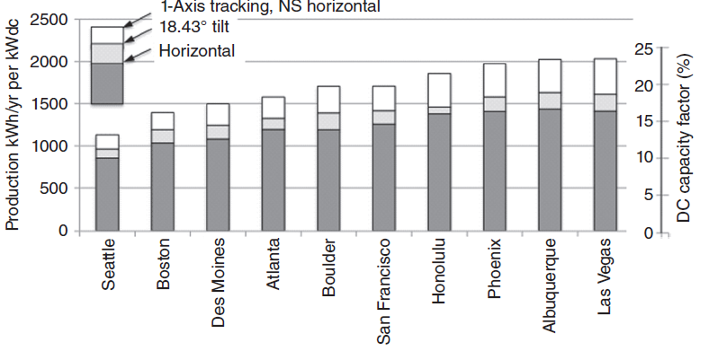
Capacity Factor of PV
capacity factor over a period of time, usually 1 year, is the ratio of the energy actually delivered to the energy that would have been delivered if the system ran at full rated power all the time.
photovoltaic DC capacity factors for a number of U.S. cities.

Slide 23
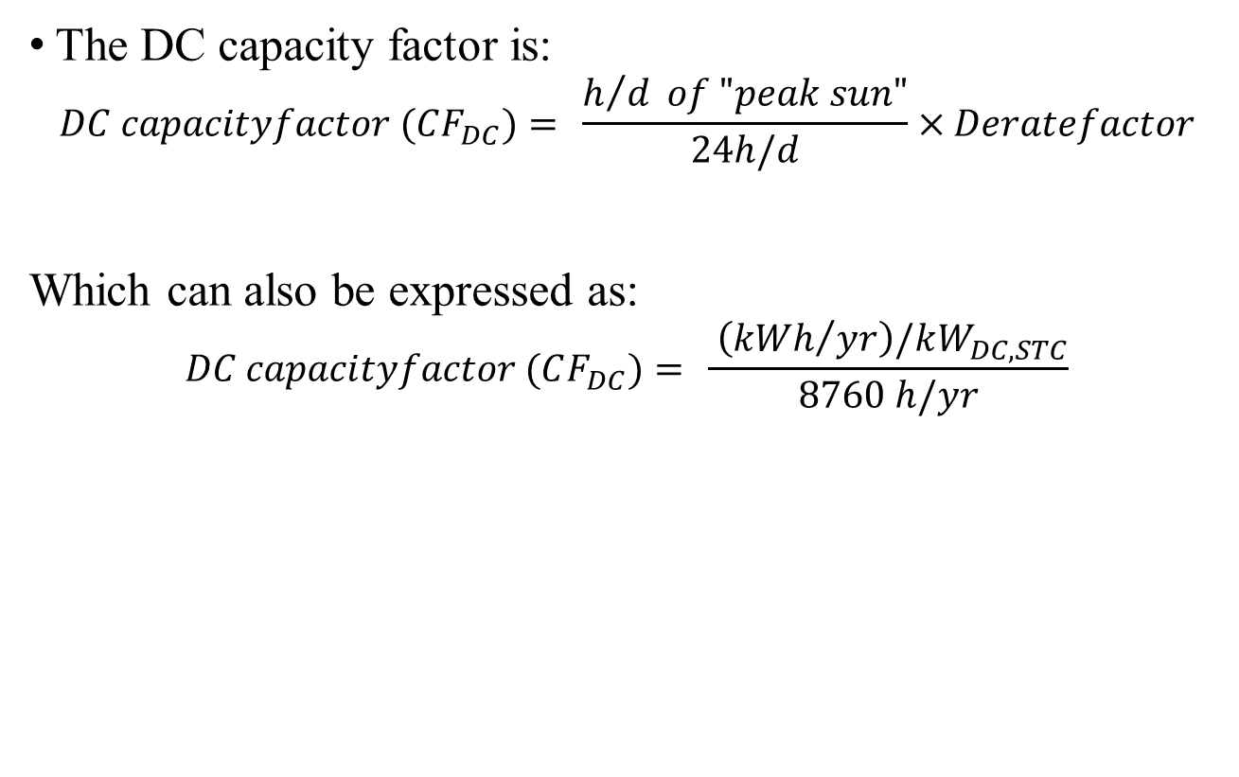
Capacity Factor of PV
The DC capacity factor is:
$$DC capacityfactor (CF_{DC})= \frac{h/d of "peak sun"}{24h/d}×Deratefactor$$
Which can also be expressed as:
$$DC capacityfactor (CF_{DC})= \frac{ \left({kWh}/{yr}\right)/kW_{DC,STC}}{8760 h/yr}$$

Slide 24
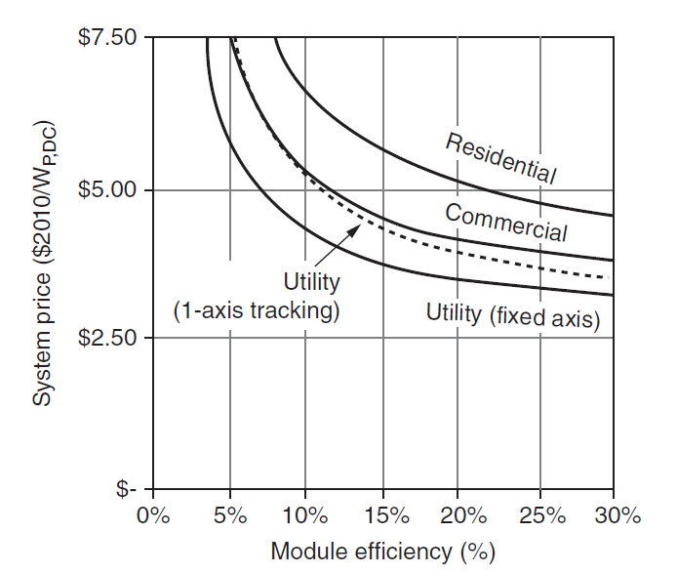
PV system economics
After the energy produced by PV array can be estimated, then we can explore their economic viability
System sizing is pretty similar for both residential and commercial buildings, but their economics differ for several reasons:
  Scale of the system
  economic incentives
An NREL sensitivity analysis of the impact of module efficiency on system prices assuming equal $/Wp PV cost.

Slide 25
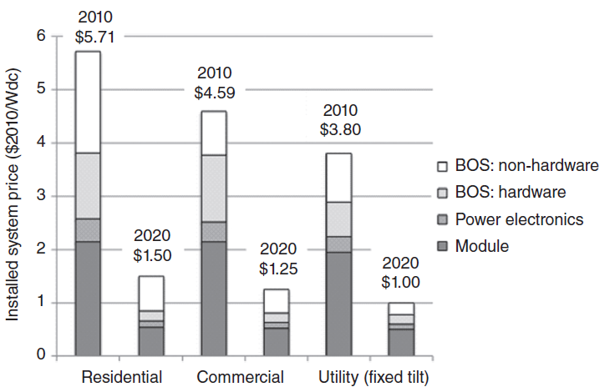
PV System Costs
Estimated 2010 prices for residential and commercial PV systems before incentives, along with SunShot goals for 2020.

Slide 26
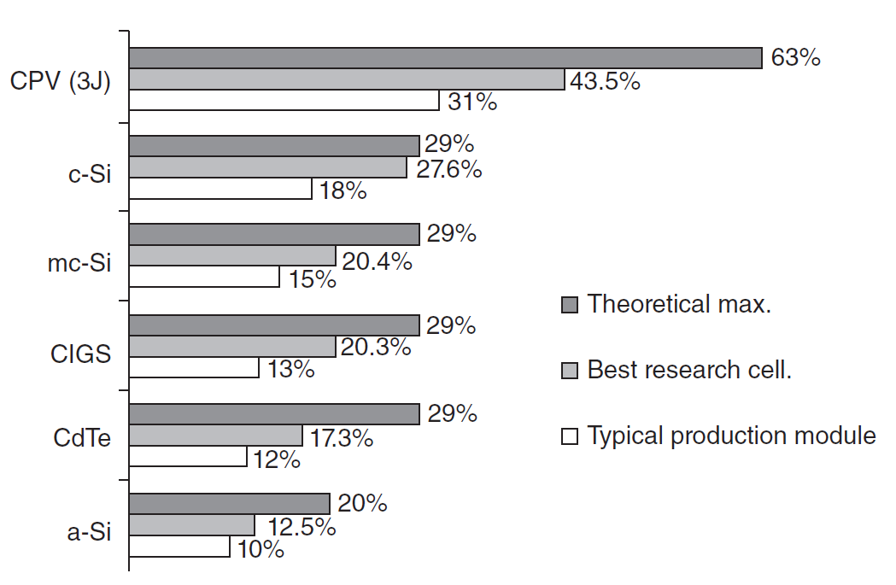
PV System Costs
The current efficiency status of competing PV technologies along with their theoretical maximum possible efficiencies.

Slide 27
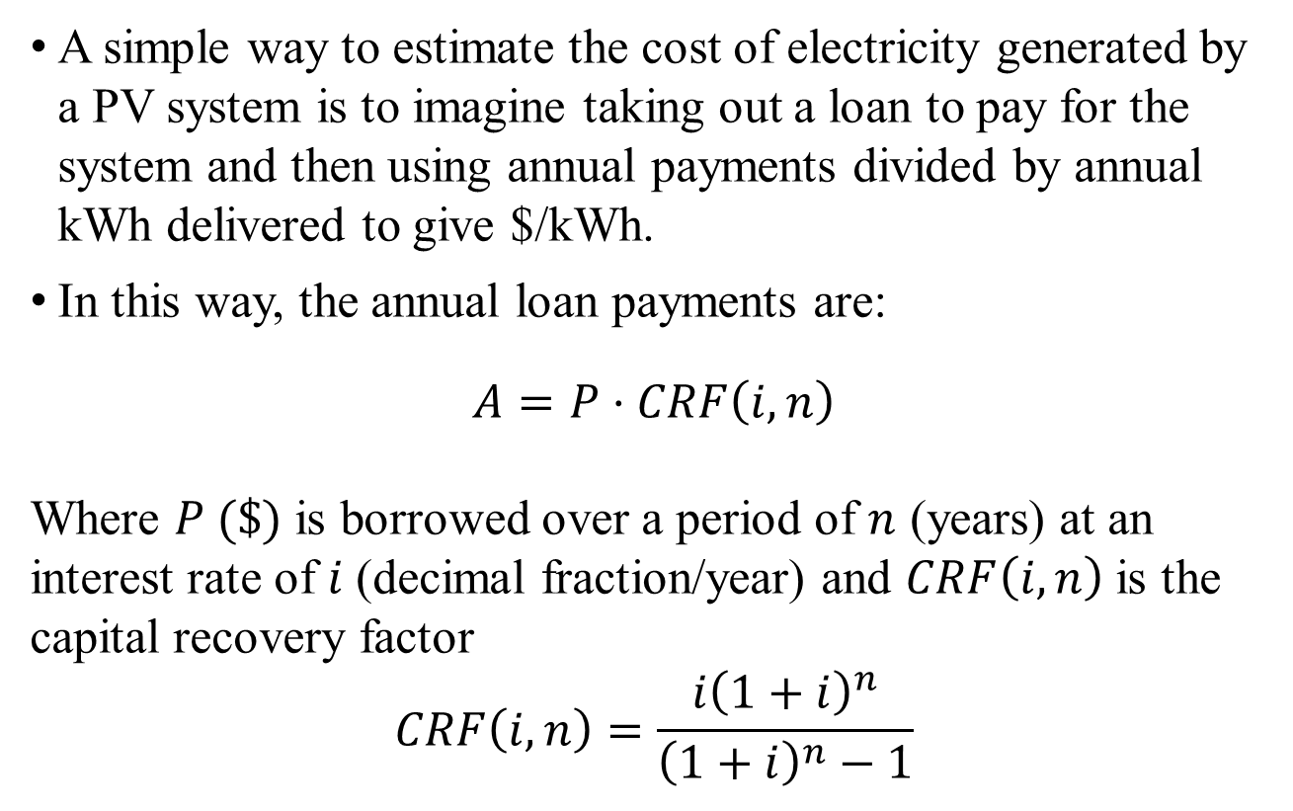
Amortizing Costs
A simple way to estimate the cost of electricity generated by a PV system is to imagine taking out a loan to pay for the system and then using annual payments divided by annual kWh delivered to give $/kWh.
In this way, the annual loan payments are:
$$A=P⋅CRF\left(i,n\right)$$
Where $P (\$)$ is borrowed over a period of $n$ (years) at an interest rate of $i$ (decimal fraction/year) and $CRF\left(i,n\right)$ is the capital recovery factor
$$CRF\left(i,n\right)=\frac{i{\left(1+i\right)}^{n}}{{\left(1+i\right)}^{n}−1}$$

Slide 28
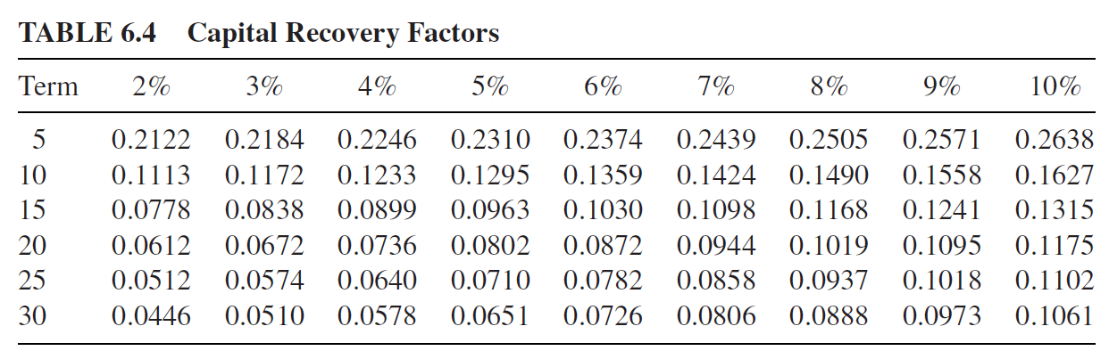

Amortizing Costs
Then, the capital recovery factor for monthly payments are
$$CRF\left(i,n\right)=\frac{\left(i/{12}\right){\left(1+\left(i/{12}\right)\right)}^{12n}}{{\left(1+\left(i/{12}\right)\right)}^{12n}−1}$$
A short table of capital recovery factors is provided below

Slide 29
Example
A 3.36kWDC PV system delivers 4942 kWh/yr. Suppose the system cost is $5.71/W_{DC} (without incentives). If the system is paid for with a 4.5%, 30-year loan, what would be its cost of electricity? (without tax incentives) If the homeowner finances the net cost of the system after receiving a 30% federal tax credit and the homeowner is in the 25% MTB, what is the cost of PV electricity in the first year? (with tax incentives)

Slide 30
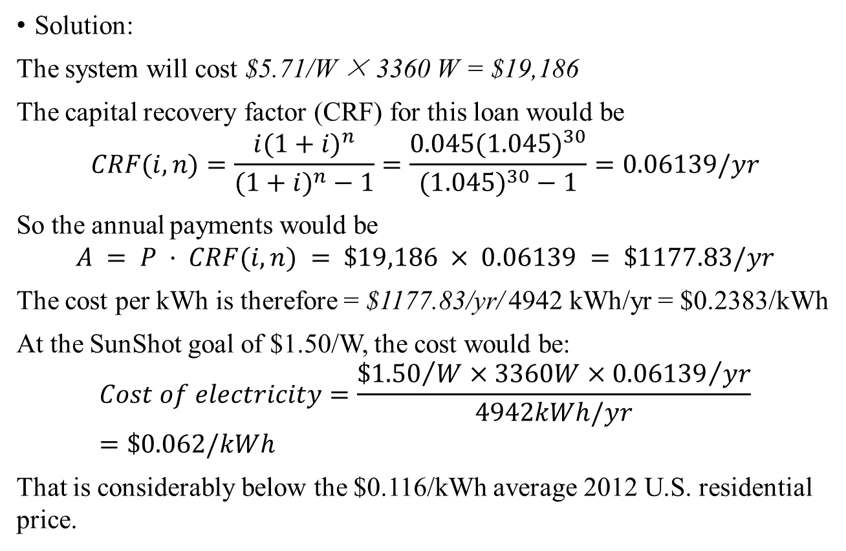
Example
Solution:
The system will cost $5.71/W × 3360 W = $19,186
The capital recovery factor (CRF) for this loan would be
$$CRF(i,n)=\frac{i(1+i)^{n}}{(1+i)^{n}−1}=\frac{0.045(1.045)^{30}}{(1.045)^{30}−1}=0.06139/yr$$
So the annual payments would be
$$A = P · CRF(i, n) = \$19,186 × 0.06139 = \$1177.83/yr$$
The cost per kWh is therefore = $1177.83/yr/ 4942 kWh/yr = $0.2383/kWh
At the SunShot goal of $1.50/W, the cost would be:
$$Cost of electricity=\frac{{\$1.50}/W×3360W×{0.06139}/{yr}}{4942kWh/yr}=\$0.062/kWh$$
That is considerably below the $0.116/kWh average 2012 U.S. residential price.

Slide 31
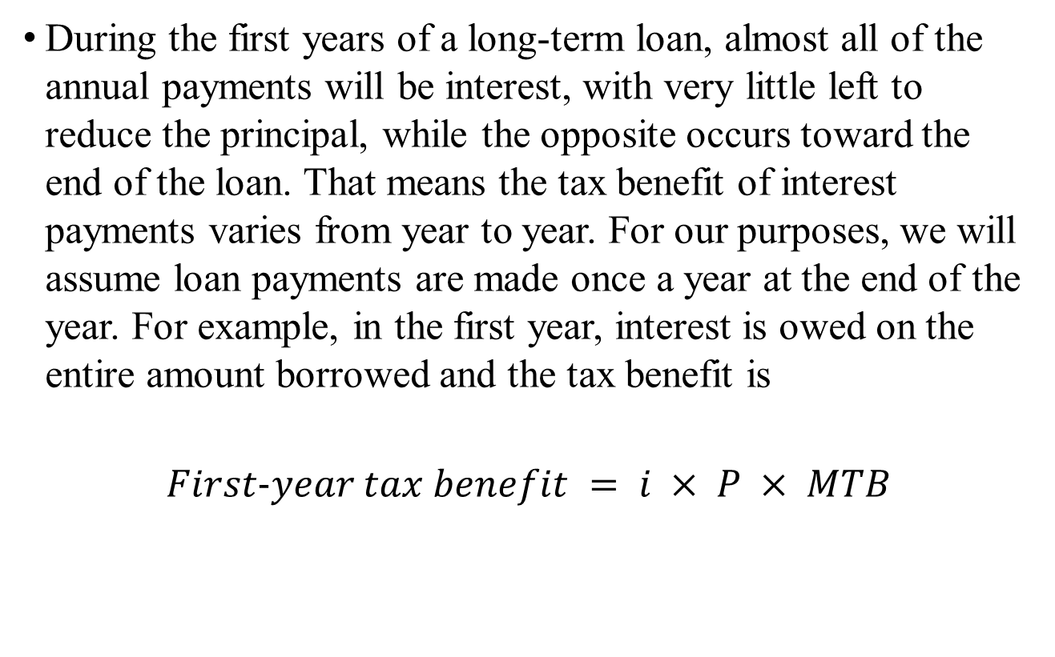
First-year tax benefit
During the first years of a long-term loan, almost all of the annual payments will be interest, with very little left to reduce the principal, while the opposite occurs toward the end of the loan. That means the tax benefit of interest payments varies from year to year. For our purposes, we will assume loan payments are made once a year at the end of the year. For example, in the first year, interest is owed on the entire amount borrowed and the tax benefit is
$$First−year tax benefit = i × P × MTB$$

Slide 32
Example
Example 6.6 Cost of PV Electricity Including Tax Benefits. The 3.36-kWDC PV system for the house in Silicon Valley costs $19,186 and delivers 4942 kWh/yr. The homeowner finances the net cost of the system after receiving a 30% federal tax credit using a 4.5%, 30-year loan. If the homeowner is in the 25% MTB, what is the cost of PV electricity in the first year?

Slide 33
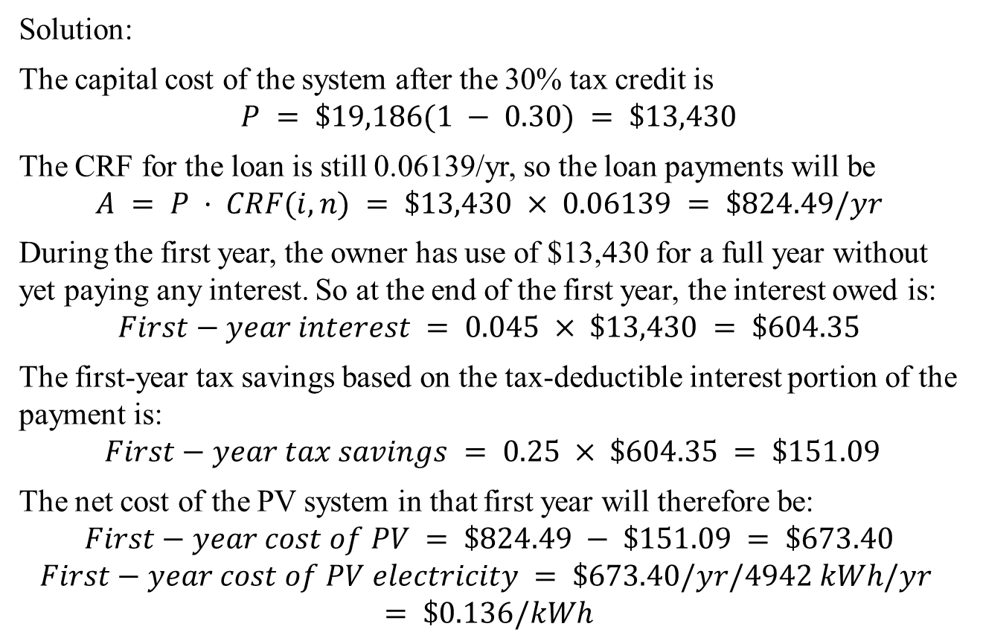
Example
Solution:
The capital cost of the system after the 30% tax credit is
$$P = \$19,186(1 − 0.30) = \$13,430$$
The CRF for the loan is still 0.06139/yr, so the loan payments will be
$$A = P · CRF(i, n) = \$13,430 × 0.06139 = \$824.49/yr$$
During the first year, the owner has use of $13,430 for a full year without yet paying any interest. So at the end of the first year, the interest owed is:
$$First−year interest = 0.045 × \$13,430 = \$604.35$$
The first-year tax savings based on the tax-deductible interest portion of the payment is:
$$First−year tax savings = 0.25 × \$604.35 = \$151.09$$
The net cost of the PV system in that first year will therefore be:
$$First−year cost of PV = \$824.49 − \$151.09 = \$673.40$$
$$First−year cost of PV electricity = \$673.40/yr/4942 kWh/yr$$
$$= \$0.136/kWh$$

Slide 34
Cash-flow Analysis
Cash flow analysis, however, easily accounts for complicating factors such as PV performance degradation, utility price escalation, declining tax-deductible interest over time, periodic maintenance costs, and disposal or salvage value of the equipment at the end of its lifetime

Slide 35
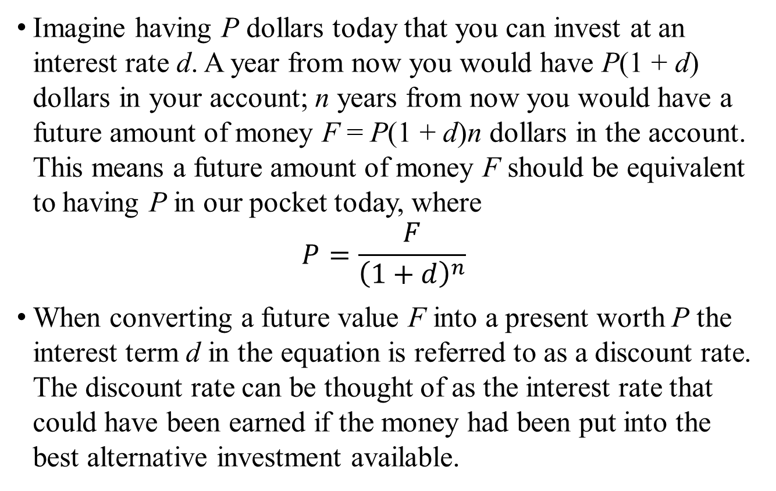
Cash-flow Analysis
Imagine having P dollars today that you can invest at an interest rate d. A year from now you would have P(1 + d) dollars in your account; n years from now you would have a future amount of money F = P(1 + d)n dollars in the account. This means a future amount of money F should be equivalent to having P in our pocket today, where
$$P=\frac{F}{{\left(1+d\right)}^{n}}$$
When converting a future value F into a present worth P the interest term d in the equation is referred to as a discount rate. The discount rate can be thought of as the interest rate that could have been earned if the money had been put into the best alternative investment available.

Slide 36
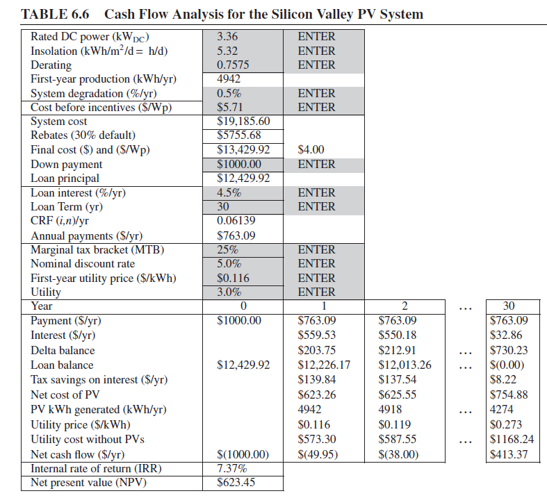
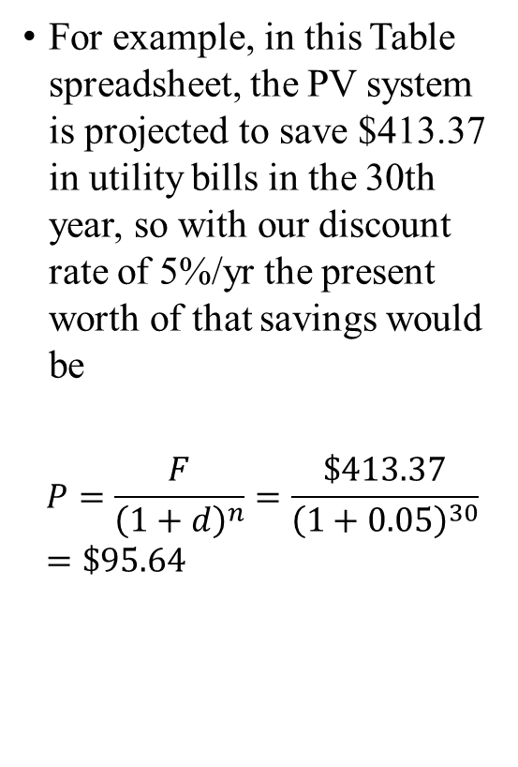
Cash-flow Analysis
For example, in this Table spreadsheet, the PV system is projected to save $413.37 in utility bills in the 30th year, so with our discount rate of 5%/yr the present worth of that savings would be
$$P=\frac{F}{{\left(1+d\right)}^{n}}=\frac{\$413.37}{{\left(1+0.05\right)}^{30}}=\$95.64$$

Slide 37
Cash-flow Analysis
In the table there is a term called IRR. The IRR is perhaps the most persuasive measure of the value of an energy efficiency or renewable energy project since it allows the energy investment to be directly compared with the return that might be obtained for any other competing investment.
Internal Rate of Return (IRR): IRR is the discount rate that makes the NPV of the energy investment equal to zero.

Slide 38
Residential Rate Structures
The rate structure for a residential customer will typically include a basic fee to cover costs of billing, meters, and other equipment, plus an energy charge based on the number of kilowatt-hours of energy used.

Slide 39
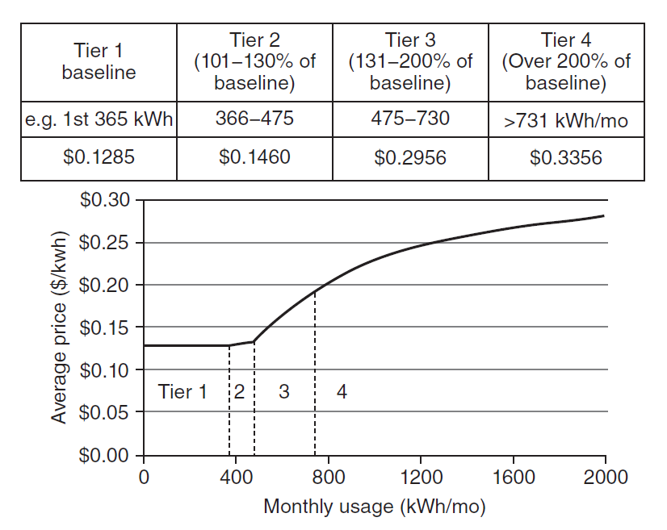
Residential Rate Structures
An example residential rate structure shown in Figure 6.18 for one of California’s major investor-owned utilities.

Slide 40
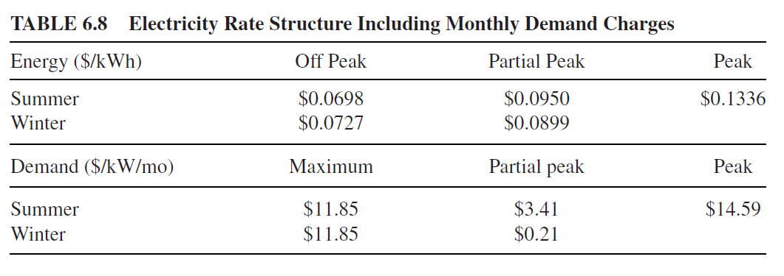
Commercial and Industrial Rate Structures
Commercial and industrial customers are usually billed not only for energy (kilowatt-hours) but also for the peak amount of power that they use (kilowatts), i.e., monthly demand charge based on the highest amount of power drawn by the facility.

Slide 41
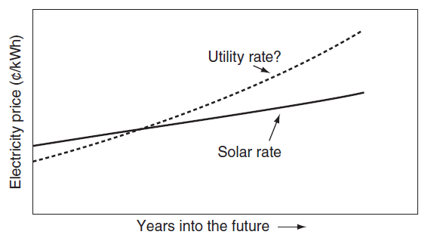
Power Purchase Agreements
Many photovoltaic systems are now being installed using third-party financing in which an outside entity contracts to finance, install, and maintain systems on the premises of their customers. In exchange, the customer signs a repayment agreement that specifies the price of electricity generated by the system over the term of the contract.
It is not uncommon for these power purchase agreements (PPAs) to start with a slightly higher unit price for solar power than what the utility offers, but the assumption is that over time it will result in net savings for the host

Slide 42
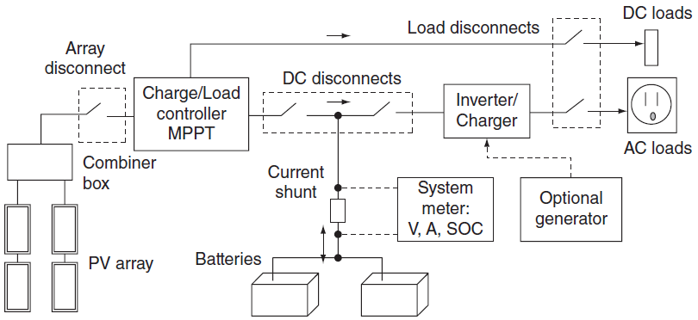
Stand-Alone PV Systems
When the grid isn’t nearby, the extra cost and complexity of a stand-alone power system can be worth the benefits
System may include batteries and a backup generator
A “one-line” diagram of the important components in a stand-alone PV system

Slide 43
Stand-Alone PV - Considerations
PV System design begins with an estimate of the loads that need to be served by the PV system
Tradeoffs between more expensive, efficient appliances and size of PVs and battery system needed
Should you use more DC loads to avoid inverter inefficiencies or use more AC loads for convenience?
What fraction of the full load should the backup generator supply?
Power consumed while devices are off
Inrush current used to start major appliances

Slide 44
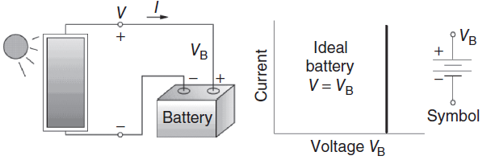
Self-regulating Modules
Real batteries can be modeled with an equivalent circuit consisting of an ideal battery of voltage V_{B} in series with an internal resistance R_{i}. During charging, V = V_{B} + I.R_{i}

Slide 45
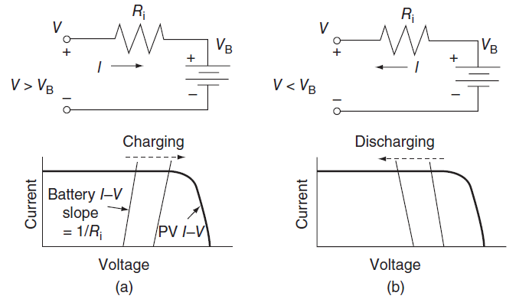
Real battery I-V curves
Real battery (a) Charging (b) Discharging (?)
Low SOC
High SOC

Slide 46
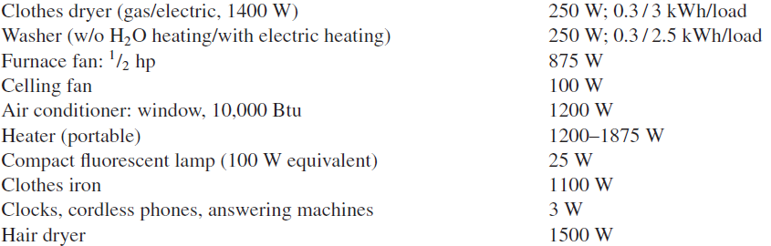
Power Requirements of Typical Loads
Table 6.11 SHOWS COMPLETE Power Requirements of typical household loads
Note that these tables are useful for getting an idea of the average values, but the best data comes from actual measurements!

Slide 47
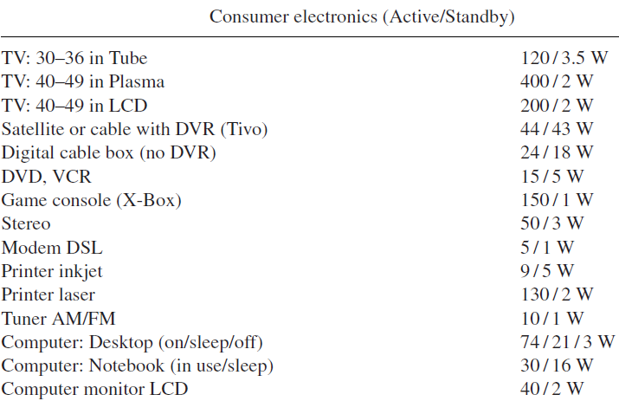
Consumer Electronics as Loads
Consider the power when the device is actively used
Also consider the power consumed when device is in standby
Table 6.11 – Power Requirements of typical household loads

Slide 48
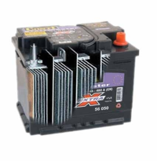
Batteries and PV Systems
Batteries in PV systems provide storage, help meet surge current requirements, and provide a constant output voltage
Lead-acid batteries are still the most commonly-used batteries for PV systems
The lead-acid battery is an electrical storage device that uses a reversible chemical reaction to store energy.
Lead-acid batteries date back to the 1860s
http://img.alibaba.com/photo/11244127/Lead_Acid_Batteries.jpg

Slide 49
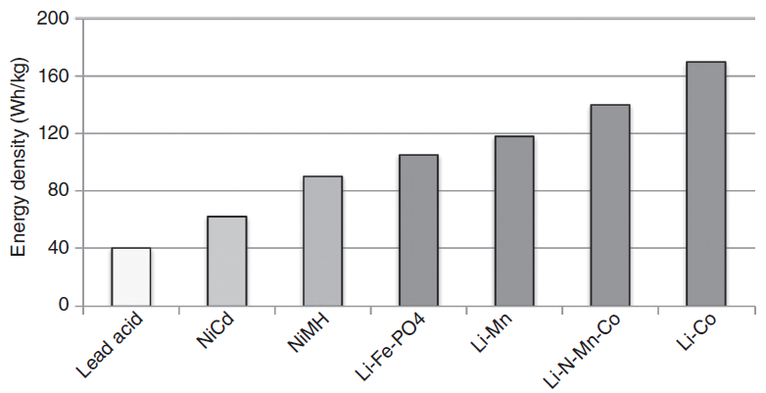
Comparison of battery chemical technologies based on energy density
Lead acid batteries are the cheapest although they are the heaviest and have the least energy density

Slide 50
Basics of Lead-Acid Batteries
Positive plate: PbO₂ + 4H⁺ + SO₄² ⁻ + 2e⁻ → PbSO₄ + 2H₂O (6.21)
Negative plate: Pb + SO₄²⁻ → PbSO₄ + 2e⁻ (6.22)
A lead-acid battery in its charged and discharged states

Slide 51
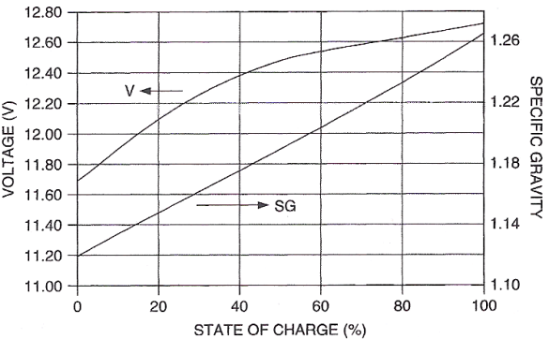
Basics of Lead-Acid Batteries
(Specific Gravity)
During discharge, voltage drops and specific gravity of electrolyte drops
Sulfate adheres to the plates during discharge and comes back off when charging, but some of it becomes permanently attached

Slide 52
Stand-Alone PV Systems – Design Summary
Analysis of load
  Determine daily demands for power and energy
  What fraction of the worst month “design month” should you cover with the PV system? How much should you cover with a backup generator?
  What PV system voltage should you have?
  Convert total DC load to amp hours @ system voltage
PV sizing
  Pick a PV module based on insolation data for the site for the design month
  Determine how many parallel strings of modules and how many modules in each string in series

Slide 53
Battery Sizing (section 6.5.9)
(needed)
Days of battery storage needed for a stand-alone system with 95% and 99%
system availability. Peak sun hours are typically for the worst month of the year and availability is on an annual basis.

Slide 54

Battery Sizing
Approximation equations for the 99% and 95% curves:
(MDOD: maximum depth of discharge; T,DR: Temperature and discharge-rate factor-Fig. 6.28)

Slide 55
Example 6.12
Battery Sizing for the Off-Grid House in Boulder, CO. The household analyzed in Examples 6.9 and 6.10 has an expected AC demand of 6288 Wh/d. A decision has been made to size the batteries to provide a 95% system availability during an average month of the year. A backup generator will cover the other 5%. The batteries will be kept in a well-ventilated shed whose temperature may reach as low as −10◦C. Make appropriate assumptions and design the battery bank.
READ Solution on Page 377

Slide 56
Sizing the PV Array
Estimating battery charging at 1-sun to be the rated current of the PVs is a fairly conservative assumption.
The Ah delivered from the batteries to the load:

Slide 57
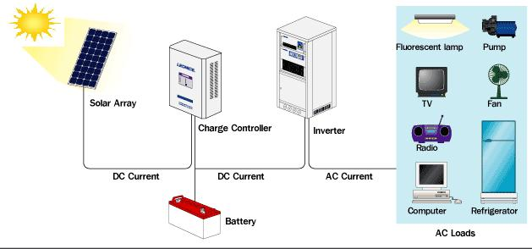
Stand-Alone PV Systems – Design Summary
Battery Sizing – How many days of storage needed?
Generator Sizing
System Costs
http://www.ecosolarenergy.com.au/How_a_Standalone_System_Works-28.htm

Slide 58
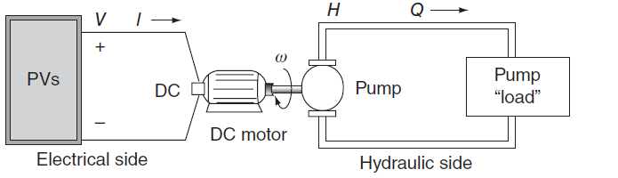
PV-Powered Water Pumping
A simple, directly coupled PV-pump system has an electrical side in which PVs create a voltage V that drives current I through wires to a motor load, and a hydraulic side in which a pump creates a pressure, H (for head) that drives water at some flow rate Q through pipes to some destination.
The electrical characteristics of the PV–motor combination need to be
matched to the hydraulic characteristics of the pump and its load

Slide 59
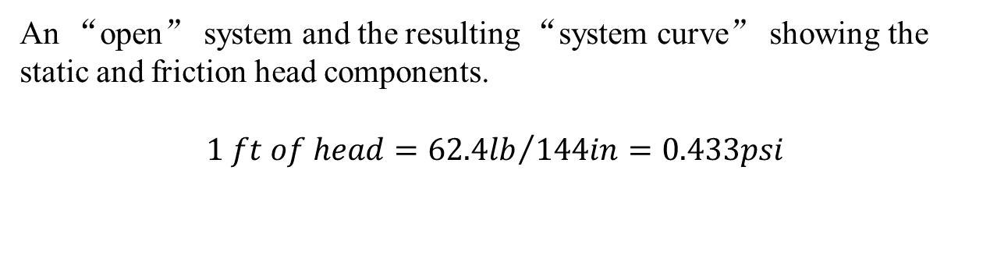
Hydraulic System Curves
If the pump is capable of supplying only enough pressure to the column of water to overcome the static head, the water would rise in the pipe and just make it to the discharge point and then stop. In order to create flow, the pump must provide an extra amount of head to overcome friction losses in the piping system.
An “open” system and the resulting “system curve” showing the static and friction head components.
$$1 ft of head={62.4lb}/{144in}=0.433psi$$

Slide 60
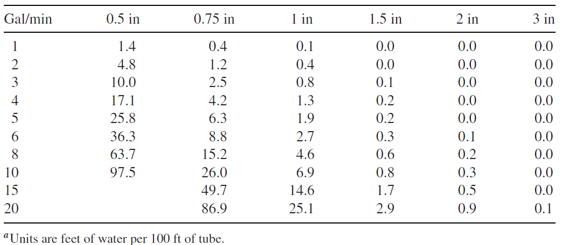
Hydraulic System Curves
Pressure Loss Due to Friction in Plastic Pipe, Feet of Water per 100 ft of Tube for Various Nominal Tube Diameters

Slide 61
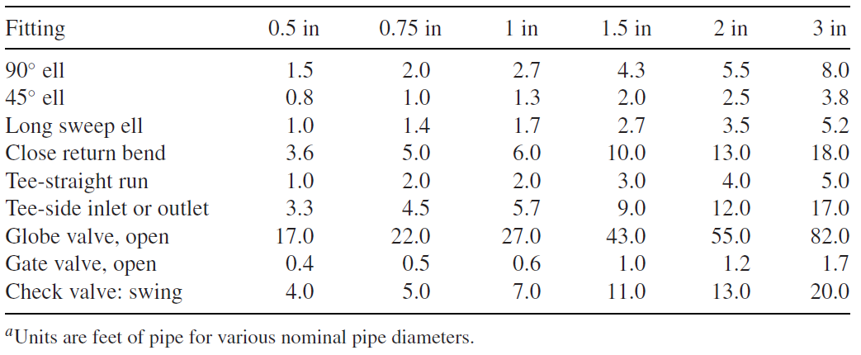
Hydraulic System Curves
Friction loss in valves and elbows expressed as equivalent lengths of tube

Slide 62
Hydraulic Pump Curves - load
The pump curves for positive displacement pumps and centrifugal pumps have quite different shapes.

Slide 63
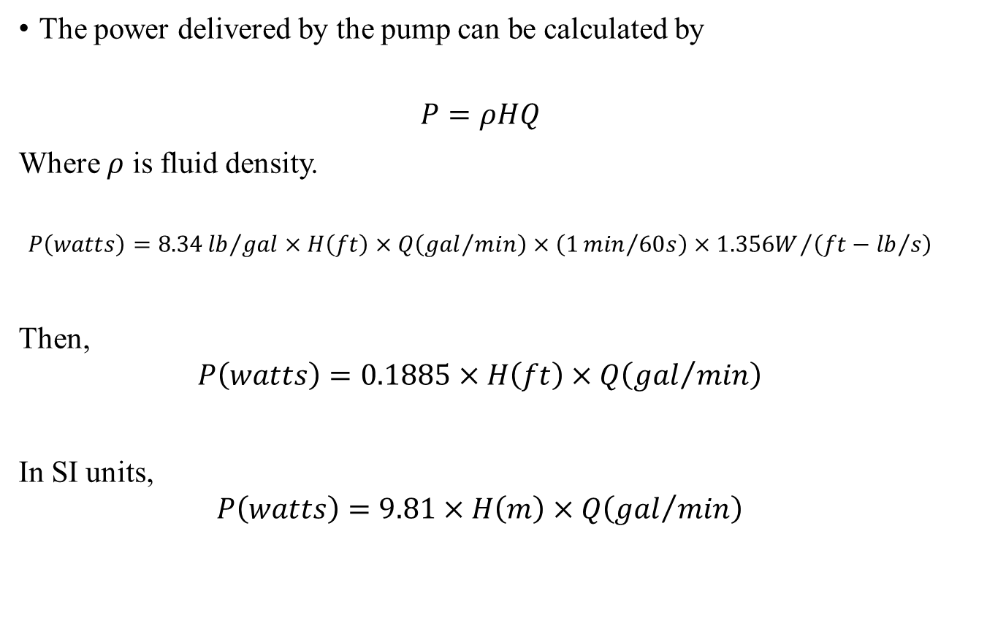
The Delivered Power by the Pump
The power delivered by the pump can be calculated by
$$P=ρHQ$$
Where $ρ$ is fluid density.
$$P\left(watts\right)=8.34{lb}/{gal}×H\left(ft\right)×Q\left({gal}/{min}\right)×\left(1{min}/{60s}\right)×{1.356W}/{\left(ft−{lb}/s\right)}$$
Then,
$$P\left(watts\right)=0.1885×H\left(ft\right)×Q\left({gal}/{min}\right)$$
In SI units,
$$P\left(watts\right)=9.81×H\left(m\right)×Q\left({gal}/{min}\right)$$

Slide 64
Pump Curves for the Jacuzzi SJ1C11 DC Centrifugal Pump
Pump curves for the Jacuzzi SJ1C11 pump showing pump efficiency for
various input voltages. Pump efficiencies are also shown, with the peak along the knee of the curves.

Slide 65
Hydraulic System Curve
Hydraulic System Curve and Pump Curve Combined to determine hydraulic operating point
The system curve for the example, superimposed onto the pump curves for
the Jacuzzi SJ1C11. No flow occurs until pump voltage exceeds about 40 V.

Slide 66
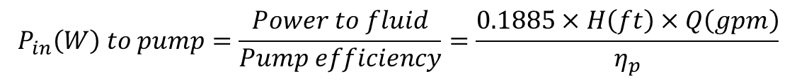
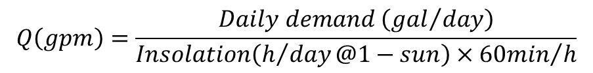
A Simple Directly Coupled PV–Pump Design Approach
The pump power
$$P_{in}\left(W\right) to pump=\frac{Power to fluid}{Pump efficiency}=\frac{0.1885×H\left(ft\right)×Q\left(gpm\right)}{η_{p}}$$
The sizing procedure is based on the following simple steps:
Determine the water production goal (gallons/day) in the design month (highest water need and lowest insolation).
Use design-month insolation (hours @ 1-sun) as the hours of
pumping to find the pumping rate:
$$Q\left(gpm\right)=\frac{Daily demand \left({gal}/{day}\right)}{Insolation\left(h/{day}@1−sun\right)×{60min}/h}$$

Slide 67
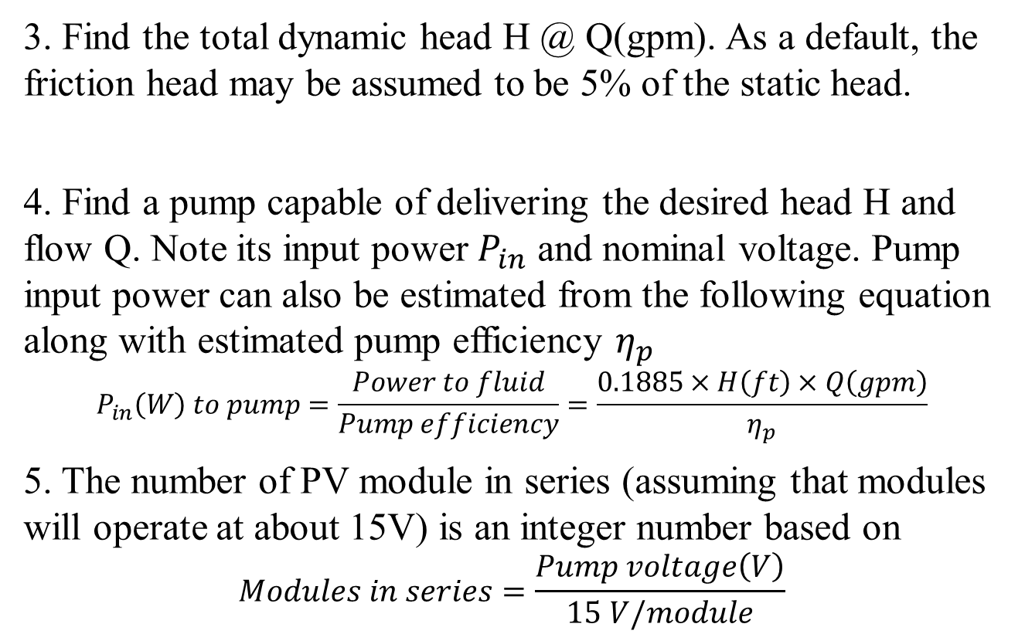
A Simple Directly Coupled PV–Pump Design Approach
3. Find the total dynamic head H @ Q(gpm). As a default, the friction head may be assumed to be 5% of the static head.
4. Find a pump capable of delivering the desired head H and flow Q. Note its input power $P_{in}$ and nominal voltage. Pump input power can also be estimated from the following equation along with estimated pump efficiency $η_{p}$
$$P_{in}\left(W\right) to pump=\frac{Power to fluid}{Pump efficiency}=\frac{0.1885×H\left(ft\right)×Q\left(gpm\right)}{η_{p}}$$
5. The number of PV module in series (assuming that modules will operate at about 15V) is an integer number based on
$$Modules in series=\frac{Pump voltage\left(V\right)}{15 V/module}$$

Slide 68
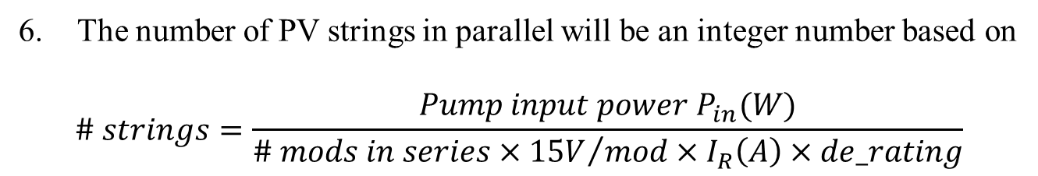
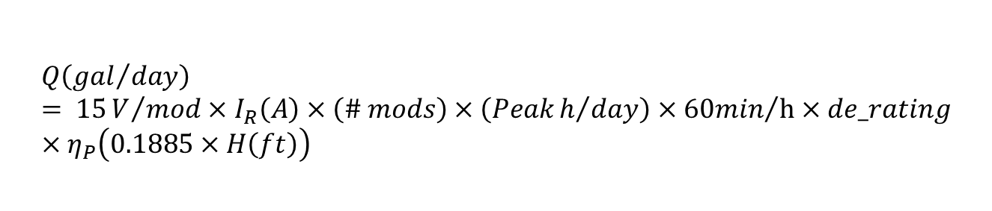
A Simple Directly Coupled PV–Pump Design Approach
The number of PV strings in parallel will be an integer number based on
$$\# strings=\frac{Pump input power P_{in}(W)}{\# mods in series×{15V}/{mod}×I_{R}\left(A\right)×de_rating}$$
After having sized the system, the water pumped can be estimated
by rearranging (9.59) and adding in the de-rating factor:
$$Q\left({gal}/{day}\right)= 15V/{mod}×I_{R}\left(A\right)×\left(\# mods\right)×\left(Peakh/{day}\right)×{60min}/h×de_rating×η_{P}\left(0.1885×H\left(ft\right)\right)$$

Slide 69
End

